Slide 1
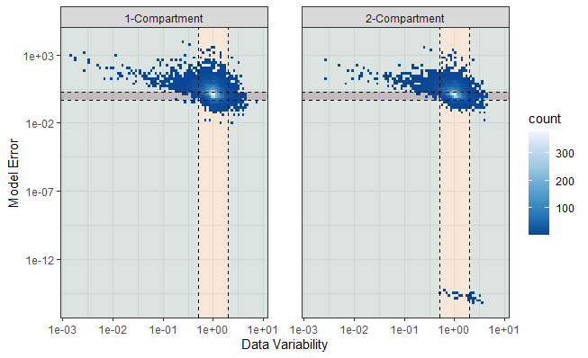
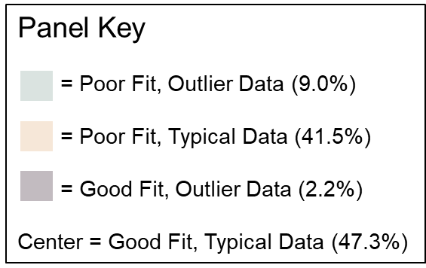
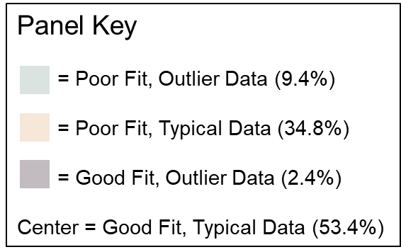
Panel Key
= Poor Fit, Outlier Data (8.8%)
= Poor Fit, Typical Data (41.0%)
= Good Fit, Outlier Data (2.5%)
Center = Good Fit, Typical Data (47.6%)
Panel Key
= Poor Fit, Outlier Data (9.3%)
= Poor Fit, Typical Data (33.4%)
= Good Fit, Outlier Data (2.4%)
Center = Good Fit, Typical Data (54.9%)

Slide 2
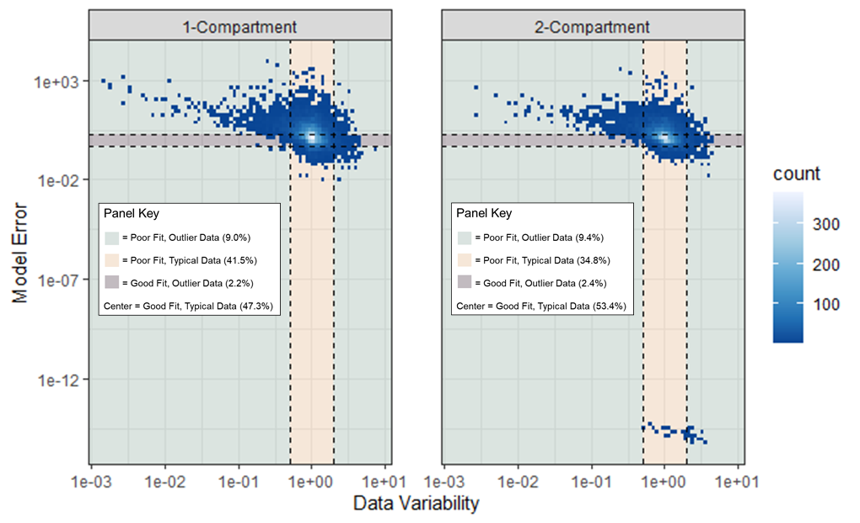

Slide 3
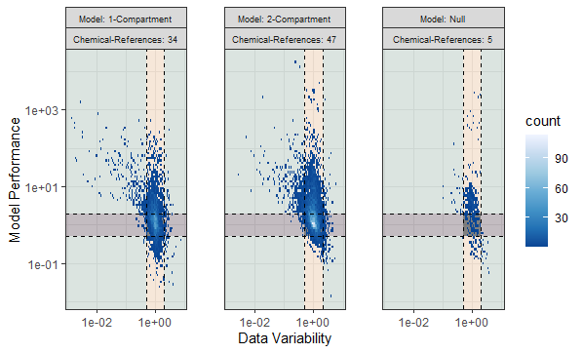
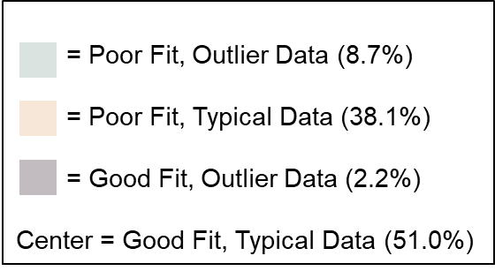
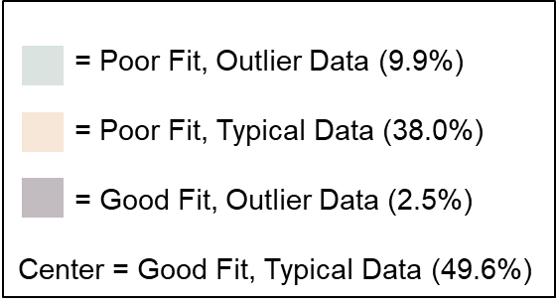
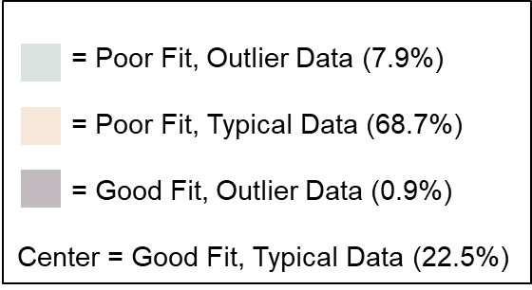
= Poor Fit, Outlier Data (8.7%)
= Poor Fit, Typical Data (38.1%)
= Good Fit, Outlier Data (2.2%)
Center = Good Fit, Typical Data (51.0%)
= Poor Fit, Outlier Data (9.9%)
= Poor Fit, Typical Data (38.0%)
= Good Fit, Outlier Data (2.5%)
Center = Good Fit, Typical Data (49.6%)
= Poor Fit, Outlier Data (7.9%)
= Poor Fit, Typical Data (68.7%)
= Good Fit, Outlier Data (0.9%)
Center = Good Fit, Typical Data (22.5%)

Slide 4
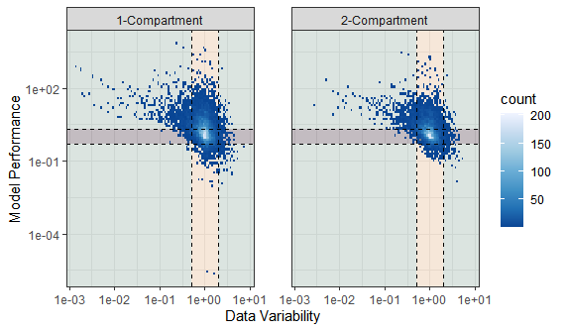
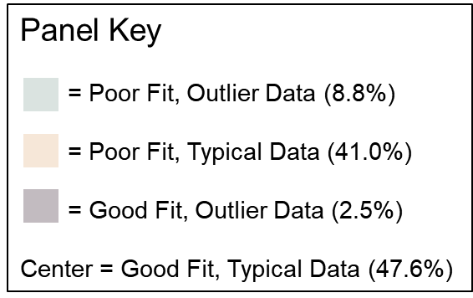
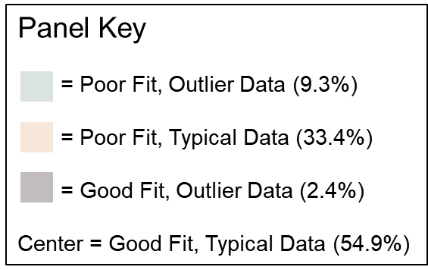
= Model Prf. < 1e-70

Slide 5
param.value.type | sigma_id | sigma_value | Data.Analyzed | Compound
Fitted geometric mean | sigma2.24 | 10 | Joint Analysis | 1, 4D
Fitted geometric mean | sigma2.6 | 15 | Joint Analysis | 1, 4D
Fitted geometric mean | sigma2.24 | 9 | 24 | 1, 4D
Fitted geometric mean | sigma2.6 | 12 | 6 | 1, 4D
param.value.type | sigma_id | sigma_value_joint | sigma_value_ind | Compound
Fitted geometric mean | sigma2.24 | 10 | 9 | 1, 4D
Fitted geometric mean | sigma2.6 | 15 | 12 | 1, 4D

Slide 6
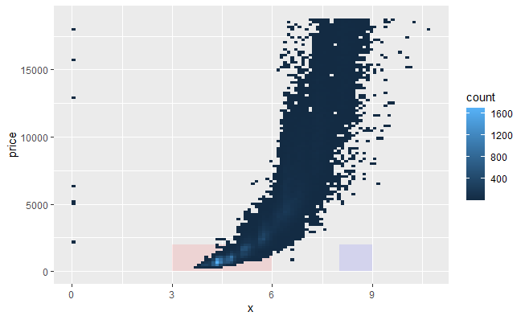
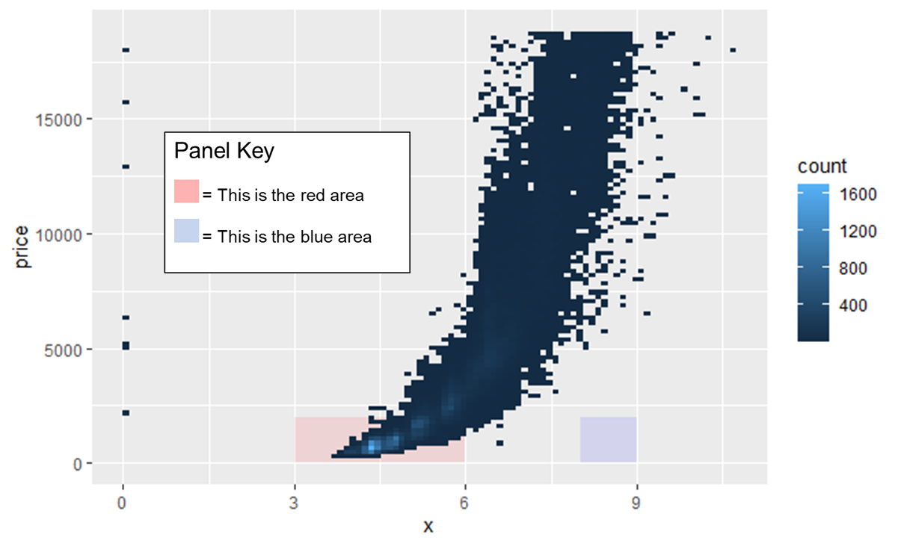
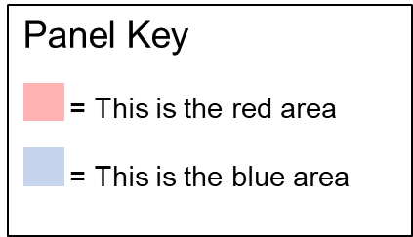

Slide 7
Abstract No. 4656
Poster Board No. P702

